Slide 1
Les quatre amis
L.O. to notice the spelling of
familiar words

Slide 2
By the end of this lesson you will be able to:
notice the spelling of familiar words.
recognise some familiar words in written form
sing a song in French.

Slide 3
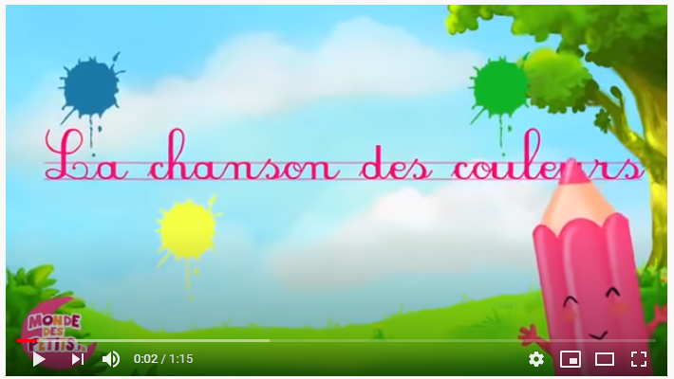
Today’s song:

Slide 4
“ch” sound
Do you remember how to say this sound?

Slide 5
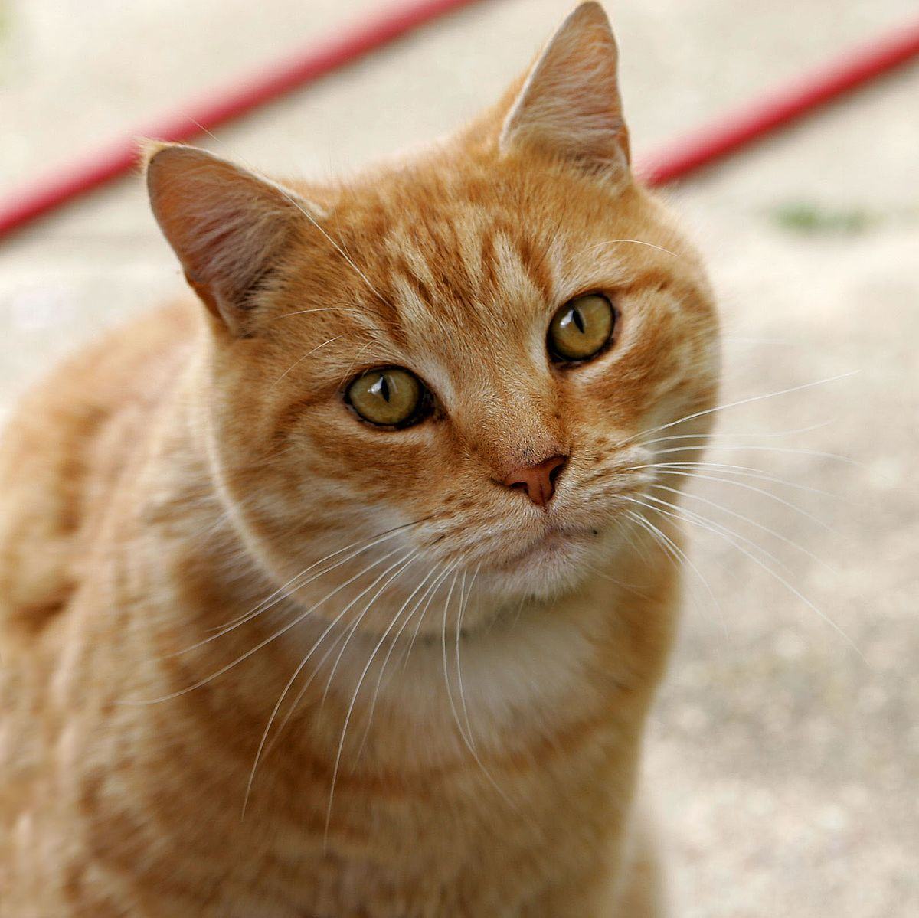
“chat”
Listen and repeat

Slide 6
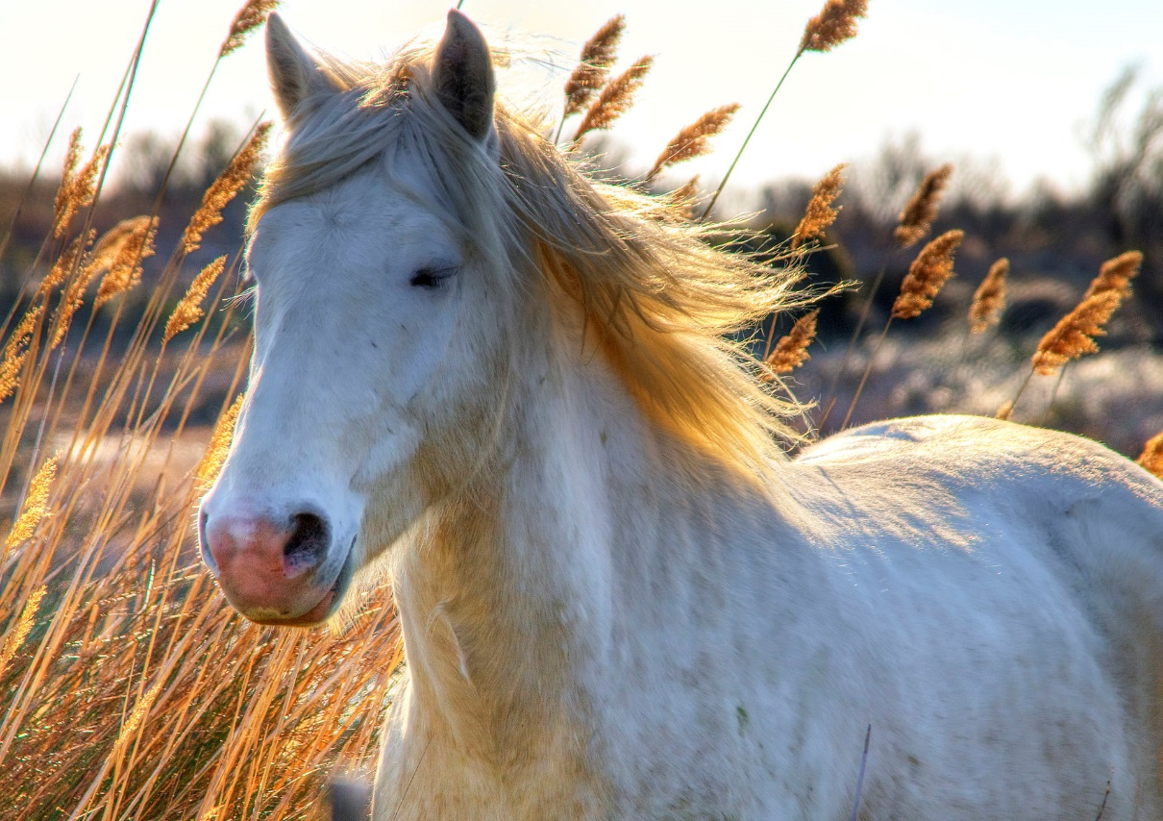
“cheval”
Listen and repeat

Slide 7
“chercher”
Listen and repeat

Slide 8
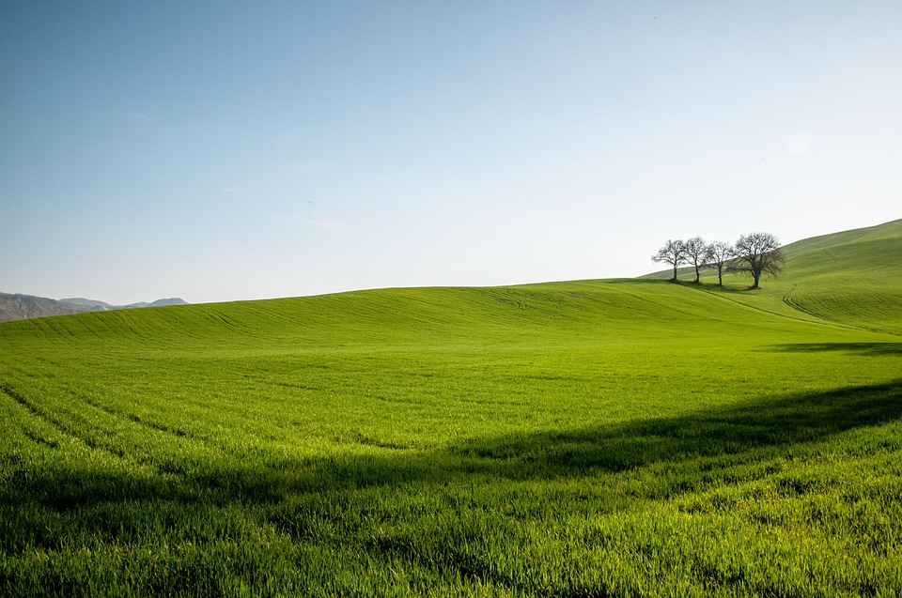
“champs”
Listen and repeat

Slide 9
Today we are going to look at: “colours”
These are the four colours in the story. Let’s learn how to spell them
blanc
noir
gris
marron

Slide 10
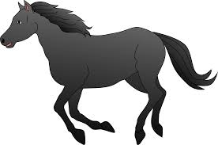
The characters and their colours:
1
le cheval est noir
Say it!

Slide 11
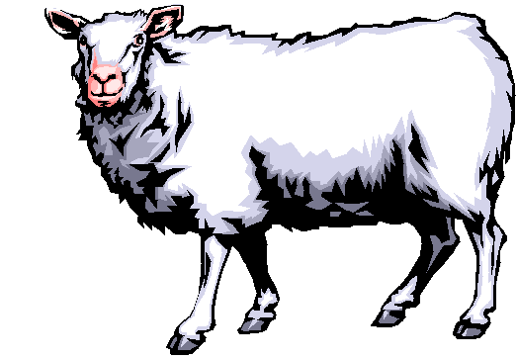
2
le mouton est blanc
Say it!

Slide 12
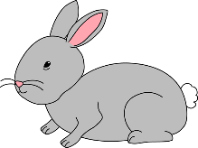
3
le lapin est gris
Say it!

Slide 13
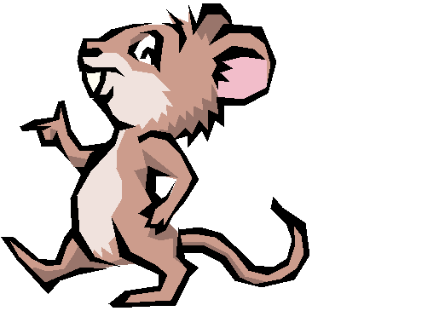
4
la souris est marron
say it!

Slide 14
From last lesson…..
Do you remember the words we use in French to describe how the different animals move?
Try to complete the sentences…

Slide 15
The characters moving around:
1
le cheval g_l_p_
Pause and write
the missing words

Slide 16
2
le mouton c_ _rt
Pause and write
the missing words

Slide 17
3
le lapin s_ _t_ll_
Pause and write
the missing words

Slide 18
4
la souris tr_tt_n_
Pause and write
the missing words

Slide 20
I can…
notice the spelling of familiar words.
recognise some familiar words in written form
sing a song in French.

