Slide 1



Building apps into daily teaching to enhance student engagement
Melody Valois
Alderley Edge School for Girls
https://mymflbox.weebly.com/
@melody.valois

Slide 2
Building apps
Apps offer a wide range of ways to enhance lessons
Apps can seamlessly integrated into lessons.
Set work + give quick feedback as it comes in
Administer quick quizzes
Allows SEND students to produce work without writing or typing
Do interactive grammar tasks
Keep a flow of work going for absentees

Slide 3
Presentation
Content
Plenty of guided learning activities
Independent activities
Which apps can I use to convey content?
Which apps can I use to activate and promote learning?
Which apps can I use to provide effective feedback, assess learning?
Practice
Production, assessment and feedback

Slide 4
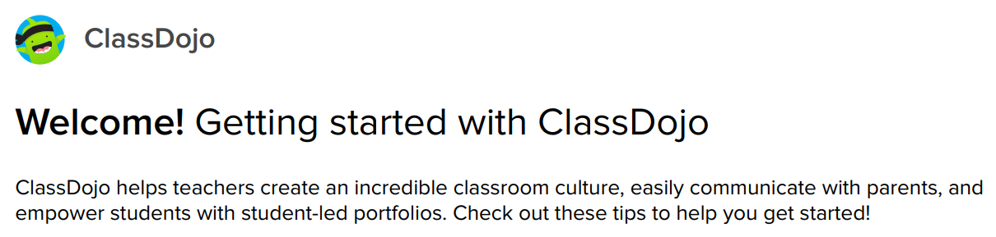
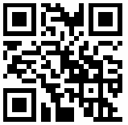
Apps for running a classroom

Slide 5
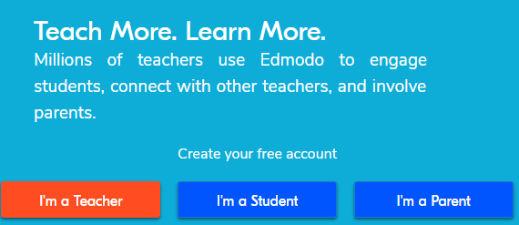
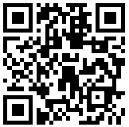
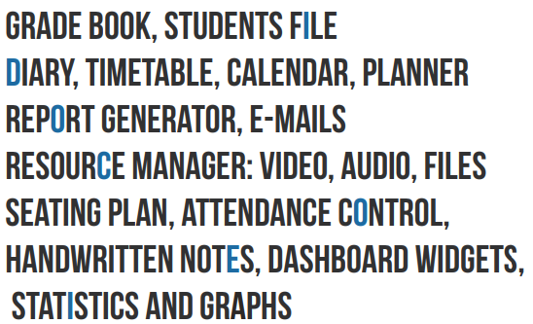

EDMODO
iDoceo

Slide 6
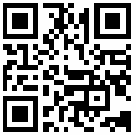
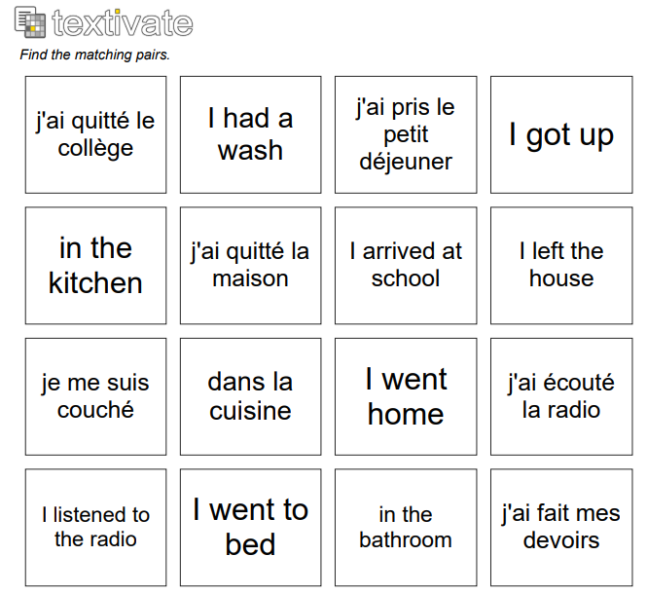
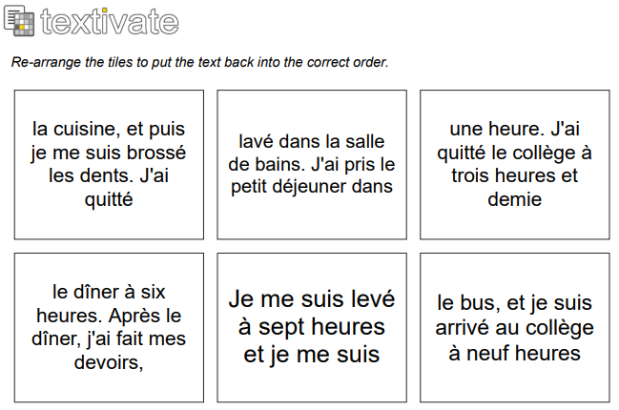
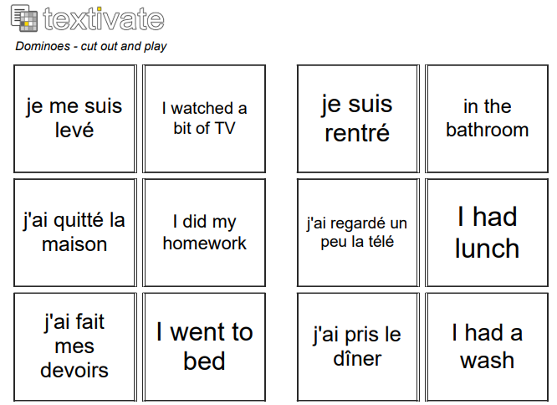
Apps for developing: Writing skills

Slide 7
Apps for developing: Writing skills

Slide 8
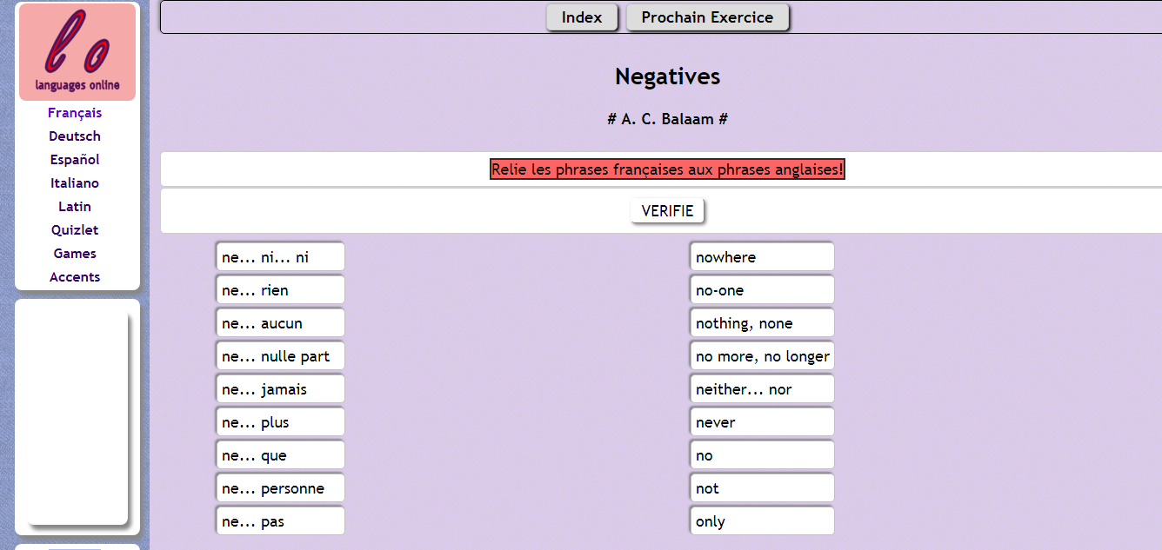
Languages online

Slide 9
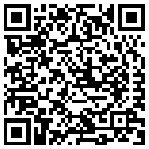


Apps for developing: Listening skills
http://www.ashcombe.surrey.sch.uk/07-langcoll/MFL-resources/french/fr-video-quizzes/1a_self_family/self_family_fset.htm

Slide 10
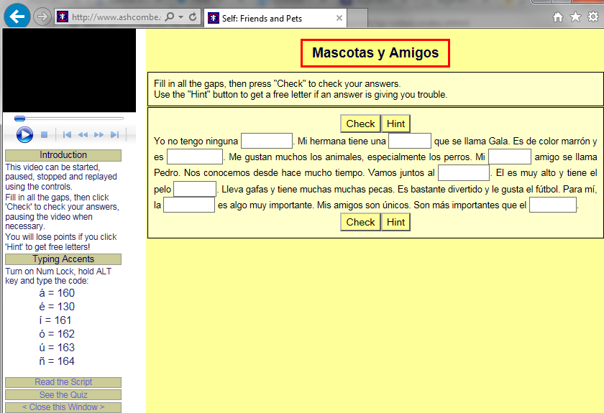

Slide 11
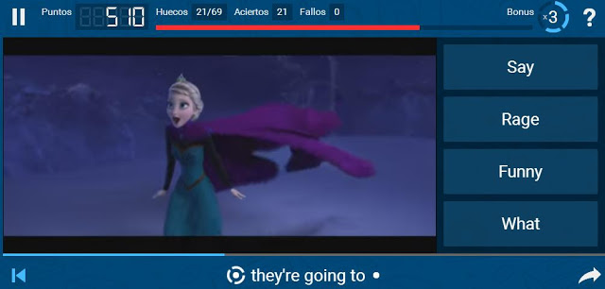



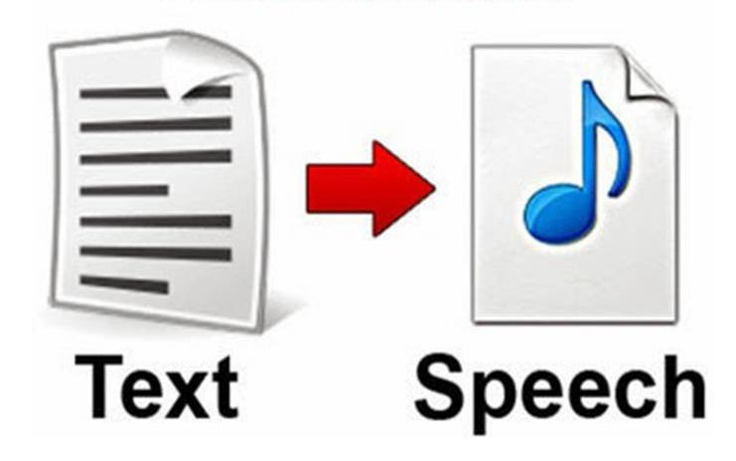
Notes:
Lyrics training is a website that links pop video in various languages. Students listen to a song and complete a gap-fill task at the bottom of the page. As you write the most recent line of the song repeats itself to give the students time to check before they move on. This is recommended to advanced-level classes who wish to do independent work. Audio Lingua has also a large bank of audio clips spoken by native speakers. You can listen online or download the files.
News in slow Spanish site offers reports at slower pace together with transcriptions, and there are equivalents for other languages.
Text to speech apps allow students to copy and paste or type texts which can then be listened to. They are useful when students have to prepare presentations or memorised answers to questions. Eg Voki

Slide 12




Apps for developing: Speaking skills

Slide 13






Apps for: vocabulary practice

Slide 14
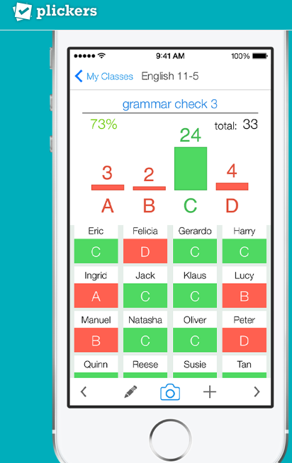
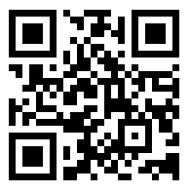

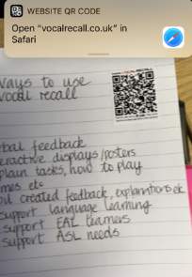

Apps for: Assessment & Feedback

Slide 15


