Slide 1
¡¡Buenas tardes a todas!! - Send me a to show that you’re ready!
The Spanish lesson will start shortly.

Slide 2
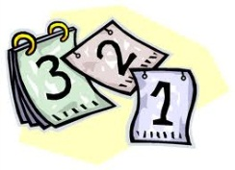
Hoy es
lunes, 6 de abril de 2020
Grammar Practice pages 72-73
L.O. Improving our understanding of grammar

Slide 3
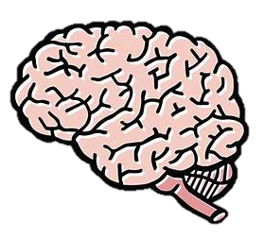
Last lesson (1)
Last week (2)
Two weeks ago (3)
Further back! (4)
Topic 4 Hispanic festivals
Retrieval Practice Challenge
How many points can you score?
1 point
Toni participated in the Tomatina festival (participamos)
2 points
What are the Fallas models made of?
3 points
Name 3 sports you play in snow/ice
2 points
What does the word “Fallas” mean?
1 point
Yesterday I went to Las Fallas (ir)
4 points
What time is it in Spanish: 1:55?
4 points
Give 3 adjectives to describe your friend’s personality
3 points
Name 3 sports in Spanish you have to play in teams
1 point
We spent a week in Valencia (pasar)

Slide 4
By the end of this lesson you will be able to:
Apply grammar in context.
Develop your exam techniques.
Revise big numbers in Spanish.

Slide 5
Task 2. Traduce las frases en página “setenta y dos”
Highlight the
spelling
changes
Task 1. Copy the “Spelling changes in the preterite” box in your book.

Slide 6
Copy in your book
Hay= there is/are
Present Tense
Había= there was /
were
Imperfect Tense
Task 3. Completa las frases con el verbo en la forma correcta. Página setenta y tres
Traduce
las
frases

Slide 7
Revising numbers
Multiples of ten apart from 20 (veinte) and 30 (treinta) end in -enta
Hundreds apart from 100 (cien) end in -ientos
Thousands -mil
For more about numbers, see pages 14-15 at the front of your book

Slide 8
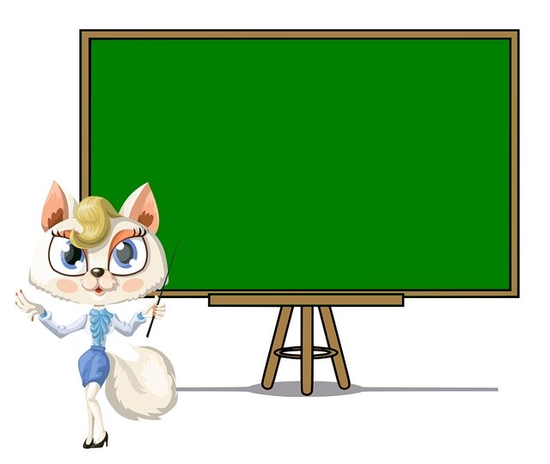
Los deberes:
Activity 4 on page 73

Slide 9
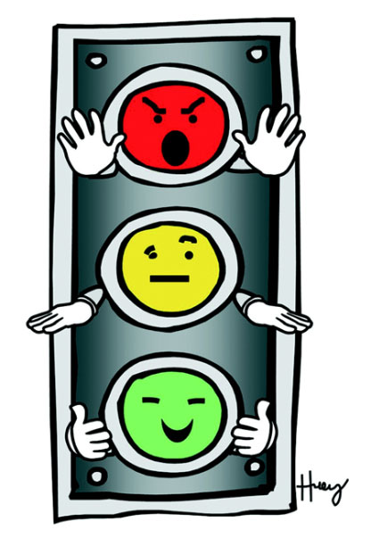
I can…
Apply grammar in context.
Develop your exam techniques.
Revise big numbers in Spanish.

