Slide 1
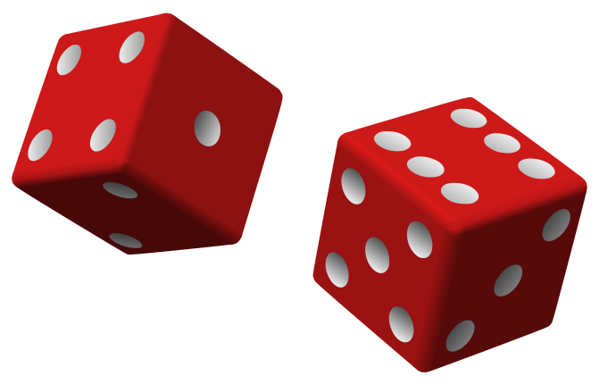
Dice discussion
Area A: Home life (casa)
General Conversation

Slide 2
Dice discussion
Area B: Self, family & personal relationships
General Conversation

Slide 3
Dice discussion
Area C: The World Around Us
General Conversation

